Slide 1
EMPLOYEE DATA ANALYSIS USING EXCEL
STUDENT NAME : M.Keerthika
Register Number : 422200494
Nm id : EE47F7B9E05846291A149E89771DBDD1
Department : B.com( Ism)
College : Valliammal College for women

Slide 2
PROJECT TITTLE
EMPLOYEE PERFORMANCE ANALYSIS USING EXCEL

Slide 3
AGENDA
PROBLEM STATEMENT PROJECT OVERVIEW END USERS OUR SOLUTION AND PROPOSITION DATA DESCRIPTION MODELING APPROACH RESULTS AND DISCUSSION CONCLUSION

Slide 4
PROBLEM STATEMENT
ANALYSING EMPLOYEE PERFORMANCE ENABLES ORGANIZATIONS TO OPTIMIZE PRODUCTIVITY BY ENSURING THAT EMPLOYEES ARE WORKING EFFICIENTLY AND EFFECTIVELY TOWARDS THEIR GOALS.

Slide 5
PROJECT OVERVIEW
ANALYZE THE SALARY OF THE EMPLOYEE BY CONSIDERING VARIOUS FACTORS LIKE GENDER, EMPLOYEE ID, START DATE, EMPLOYEE TYPE, DEPARTMENT ETC. DIFFERENT CATEGORIES OF EMPLOYEE SALARY LIKE VERY HIGH, HIGH, MEDIUM AND LOW.

Slide 6
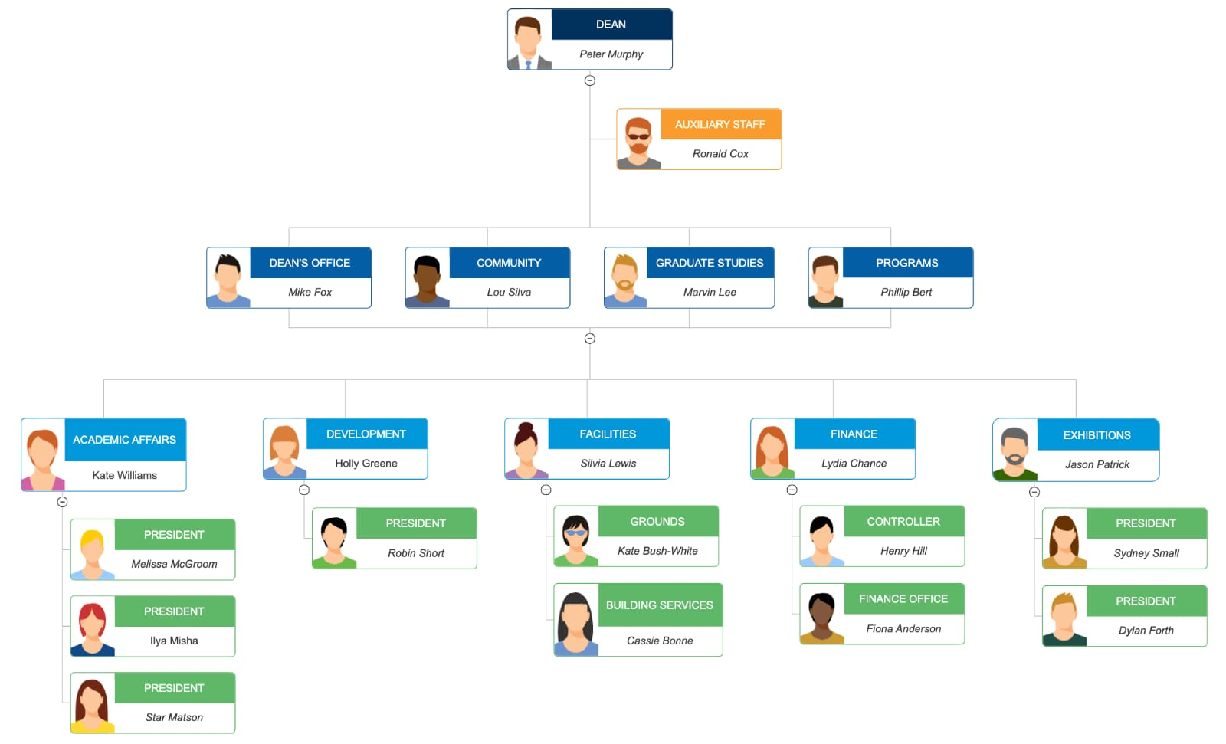
WHO ARE THE END USERS?

Slide 7
OUR SOLUTION AND IT’S VALUE PROPOSITION
. CONDITIONAL FORMATTING – MISSING • FILTER – REMOVE • FORMULA – PERFORMANCE LEVEL . PIVOT – SUMMARY .GRAPH-DATA VISUALIZATION

Slide 8
DATA SET DESCRIPTION
EMPLOYEE DATASET – EDUNET DASHBOARD 26-FEATURES 9-FEATURES EMPLOYEE ID – NUMERICAL VALUE NAME – TEXT GENDER-TEXT SALARY-NUMERICAL VALUE START DATE-NUMERICAL VALUE

Slide 9
THE “WOW” IN OUR SOLUTION
WE USE THIS FORMULA • IFS (28>=5,”VERY HIGH”, 28>=4,”HIGH”,28>=3,”MED”, TRUE”, LOW”)

Slide 10
MODELING
DATA COLLECTION NAN MUDHALVAN EDUNET DASHBOARD FEATURE SELECTION 26 FEATURES 9 FEATURES DATA CLEANING COLOUR BLANK VALUES FILTER-REMOVE BLANK

Slide 11
.SALARY LEVEL .VERY HIGH .HIGH .MEDIUM .LOW .PIVOT TABLE .EMPLOYEE ID .NAME .GENDER .SALARY .SALARY LEVEL .START DATE .EMPLOYEE TYPE

Slide 12
.CHART .EMPLOYEE ID .NAME .GENDER .SALARY .SALARY LEVEL .START DATE .EMPLOYEE TYPE .DATA VISUALIZATION

Slide 13
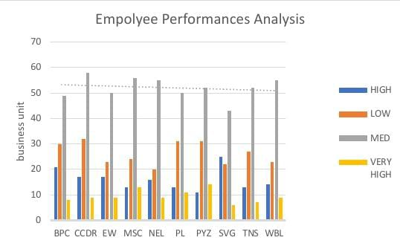
RESULT

Slide 14
CONCLUSION
WHILE COMPARING THE SALARY LEVEL OF THE EMPLOYEE THE EMPLOYEES ARE GETTING THEIR SALARYACCORDING TO THEIR EMPLOYEE TYPE AND START DATE.

